Slide 1
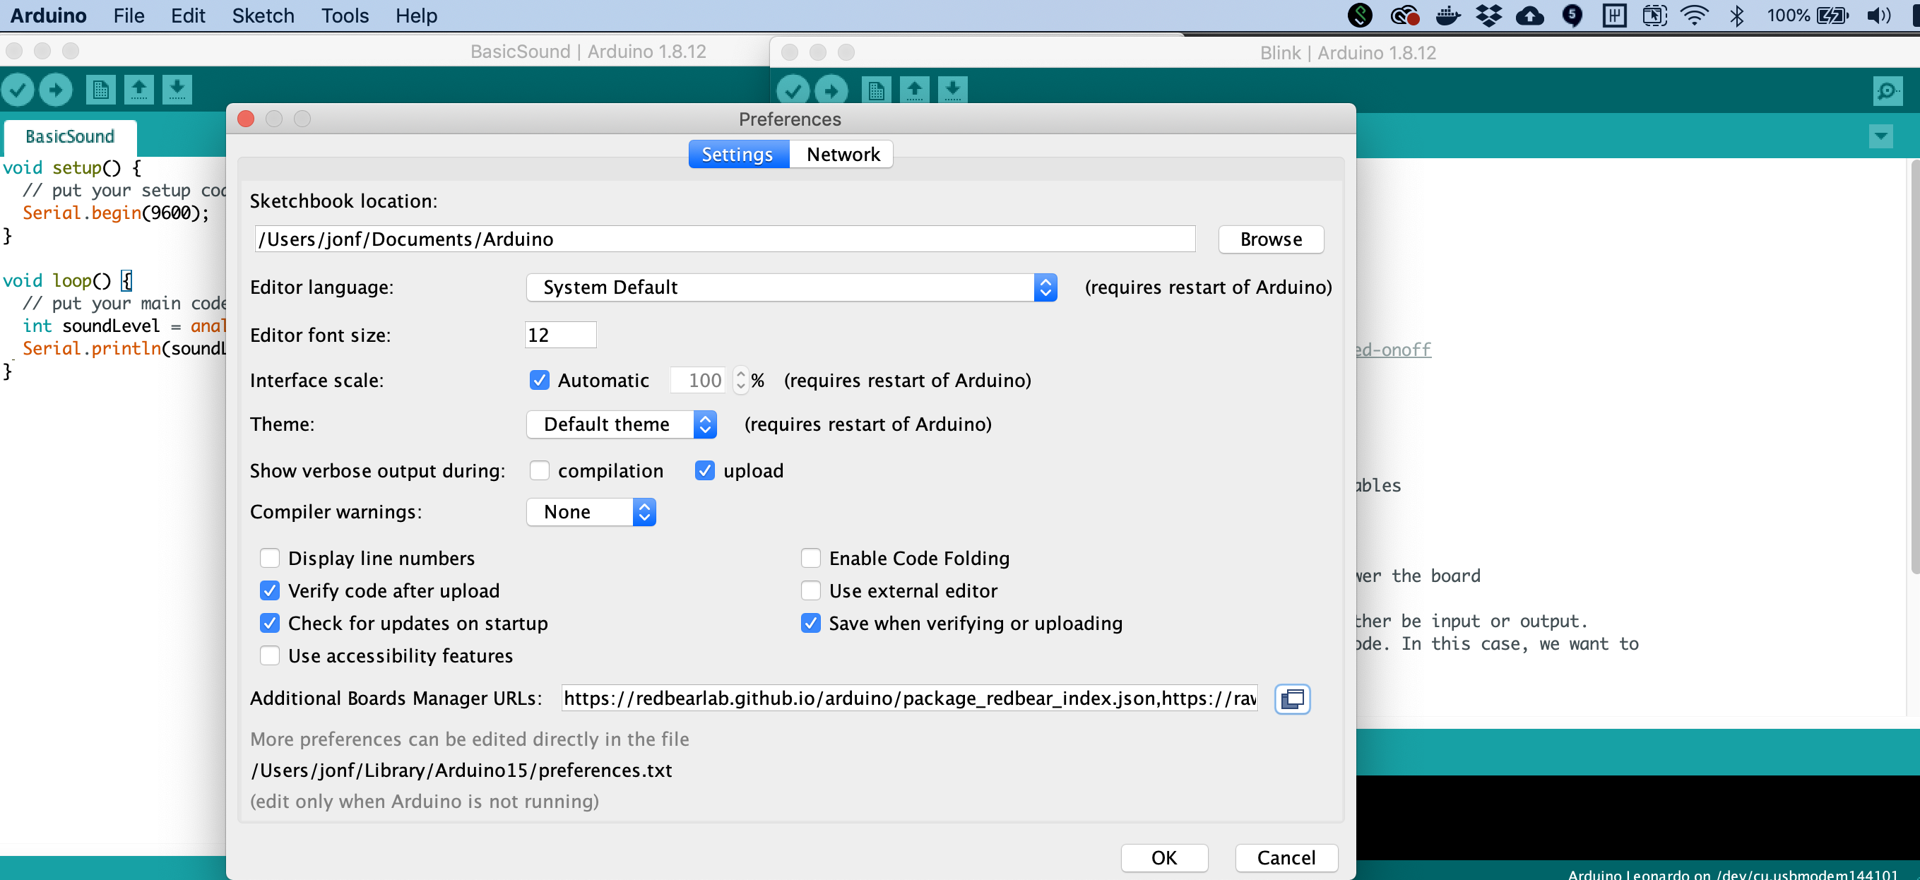

Slide 2

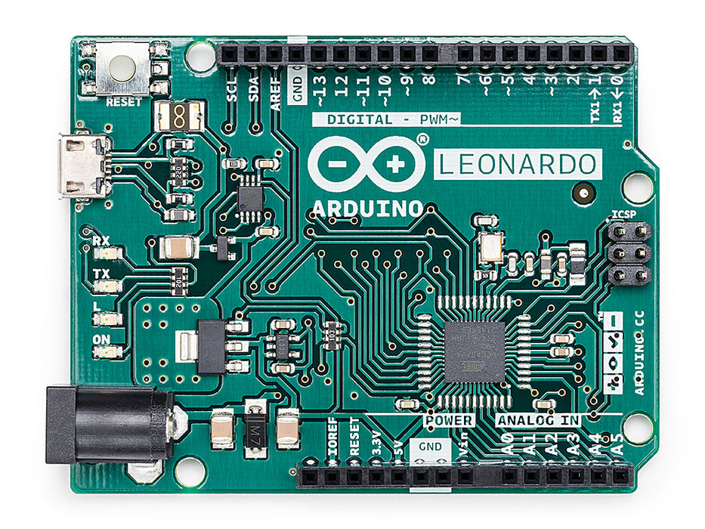
Arduino Uno
Arduino Leonardo

Slide 3
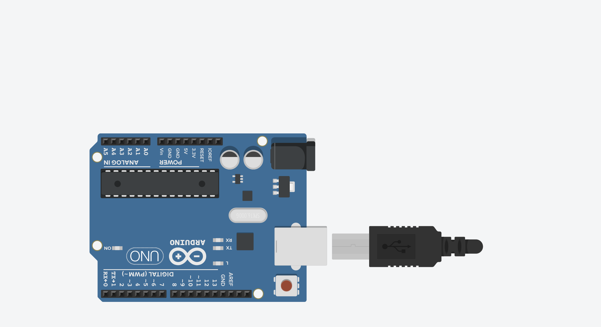
GND
5V
3.3V

Slide 4
Digital I/O Pins
The Arduino Uno has 14 digital input/output (I/O) pins, which can be used to read or write digital information via the digitalRead and digitalWrite commands, respectively.

Slide 5
Analog Output Pins
The Arduino Uno has 6 analog output pins indicated by the tilde ~, which can output a voltage signal between 0 and 5V using PWM via the analogWrite command

Slide 6
Six Analog Output Pins
The Arduino Uno has 6 analog output pins indicated by the tilde ~, which can output a voltage signal between 0 and 5V using PWM via the analogWrite command
Six Analog Input Pins
The Arduino Uno has 6 analog input pins, which can read a voltage signal between 0-5V using the analogRead command

Slide 7
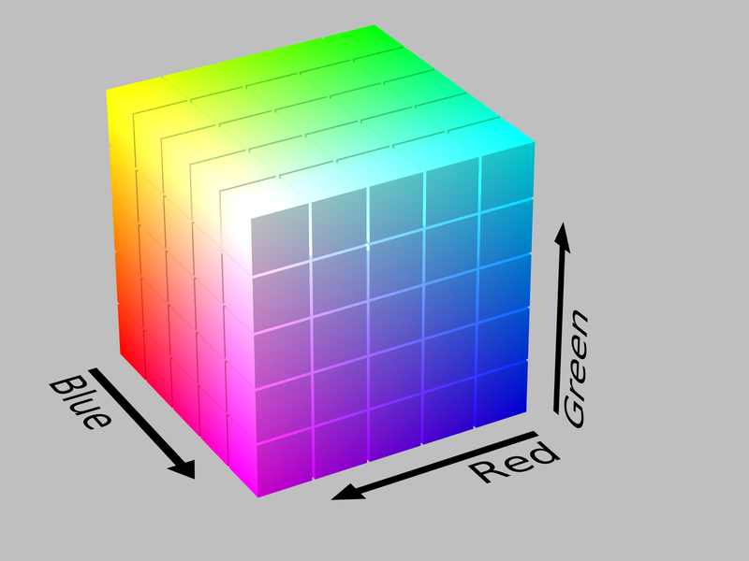
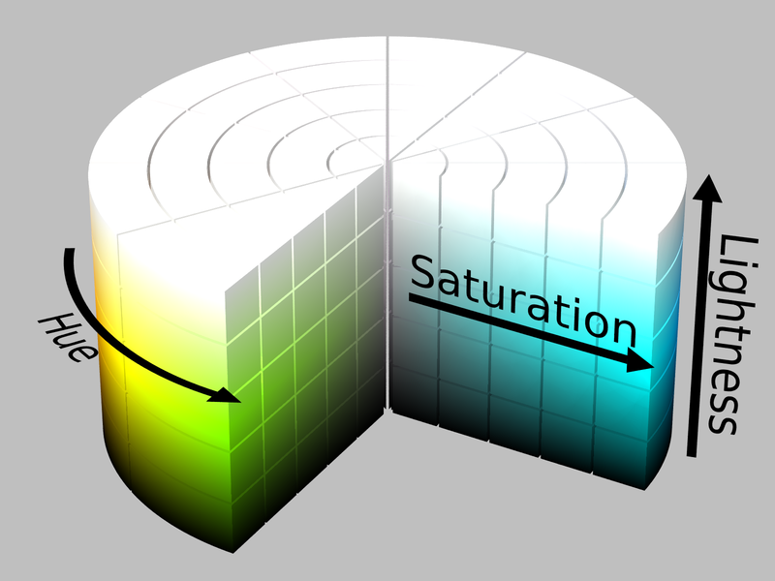
RGB Color Space
HSL Color Space
Example Values
Typically represented by (R, G, B):
Red: 0-255, Green: 0-255, Blue: 0-255
Typically represented by (H, S, L):
Hue: 0-360°, Saturation: 0-1.0, Lightness: 0-1.0
Though sometimes Hue is also 0-1.0.
RGB: 0-255, 0-255, 0-255
Red: 255, 0, 0
Green: 0, 255, 0
Blue: 0, 0, 255
Yellow: 255, 255, 0
Violet: 255, 0, 255
Cyan: 0, 255, 255
Pink: 255, 192, 203
RGB Hex code
#FF0000
#00FF00
#0000FF
#FFFF00
#FF00FF
#00FFFF
#FFC0CB
HSL: 0-1.0, 0-1.0, 0-1.0
0.0, 1.0, 0.5
0.33, 1.0, 0.5
0.66, 1.0, 0.5
0.164, 1.0, 0.5
0.835, 1.0, 0.5
0.498, 1.0, 0.5
0.972, 1.0, 0.878

Slide 8
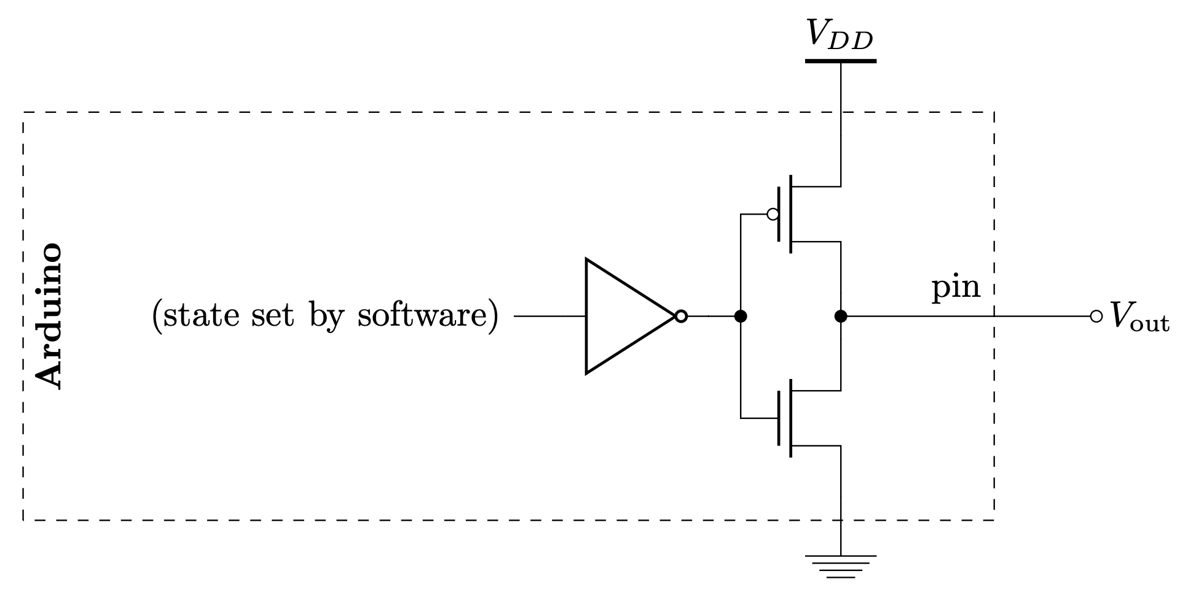
GND
Notes:
From: https://web.stanford.edu/class/archive/engr/engr40m.1178/slides/arduino.pdf
See also: https://web.stanford.edu/class/archive/engr/engr40m.1178/slides_sp17/arduino-io.pdf

Slide 9
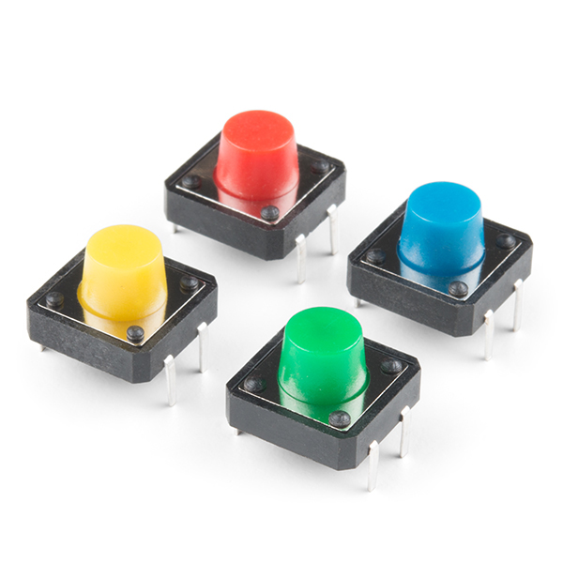
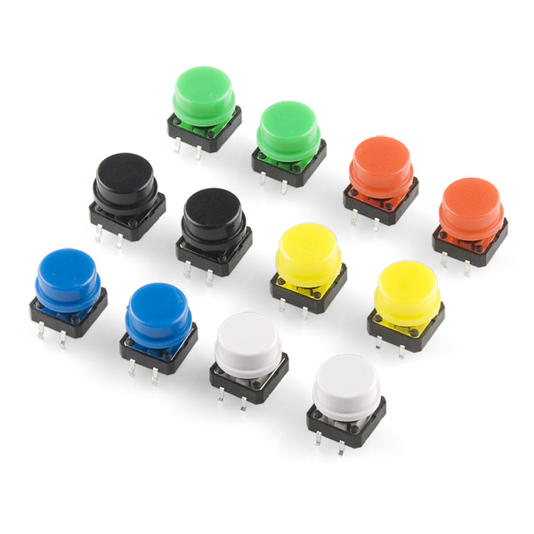
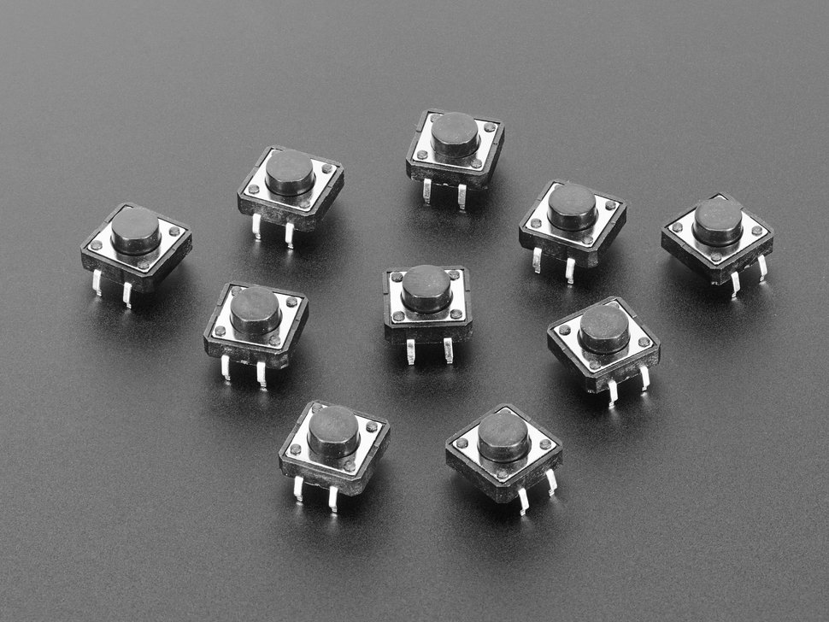
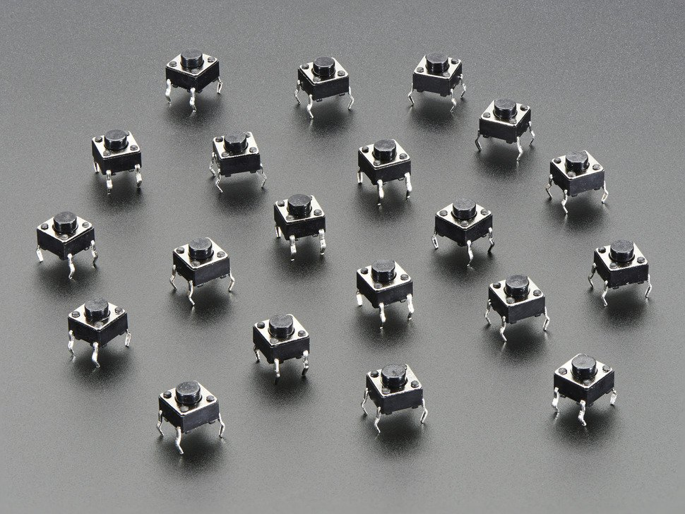
Color Tactile Buttons 1
https://www.sparkfun.com/products/14460
Color Tactile Buttons 2
https://www.sparkfun.com/products/10302
12x12mm Tactile Button Pack
https://www.adafruit.com/product/367
6x6mm Tactile Button Pack
https://www.adafruit.com/product/367

Slide 10
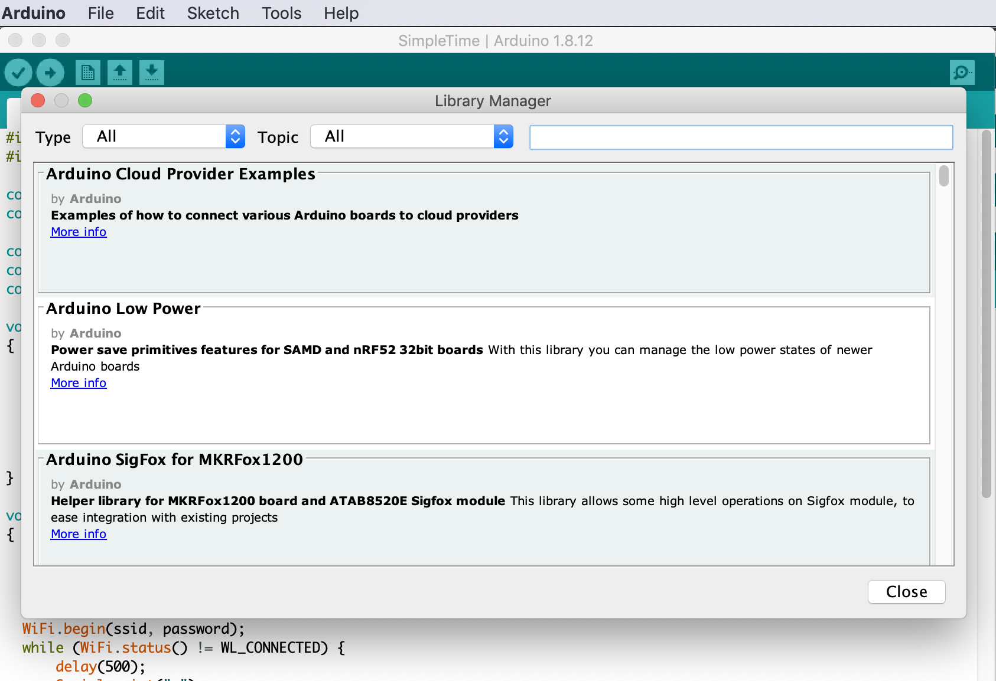

Slide 11
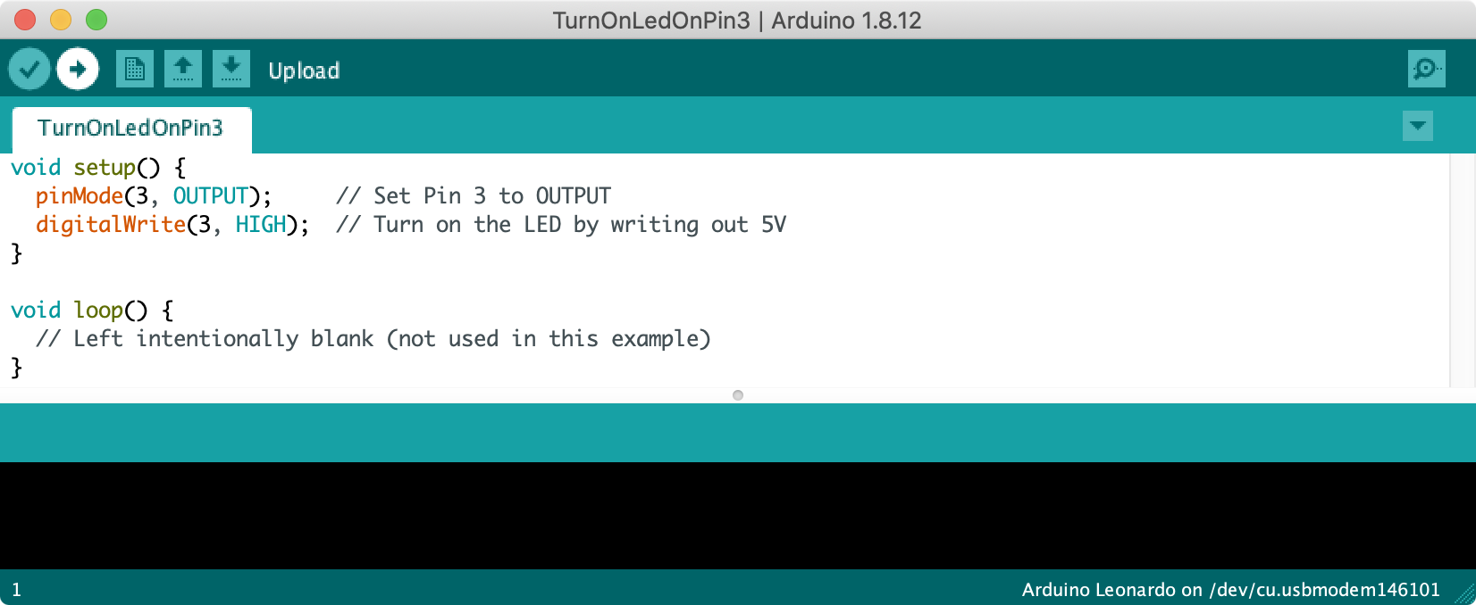
Click this arrow to upload your code. Note: you must first set your Arduino board and port in Tools->Board and Tools->Port, respectively.

Slide 12
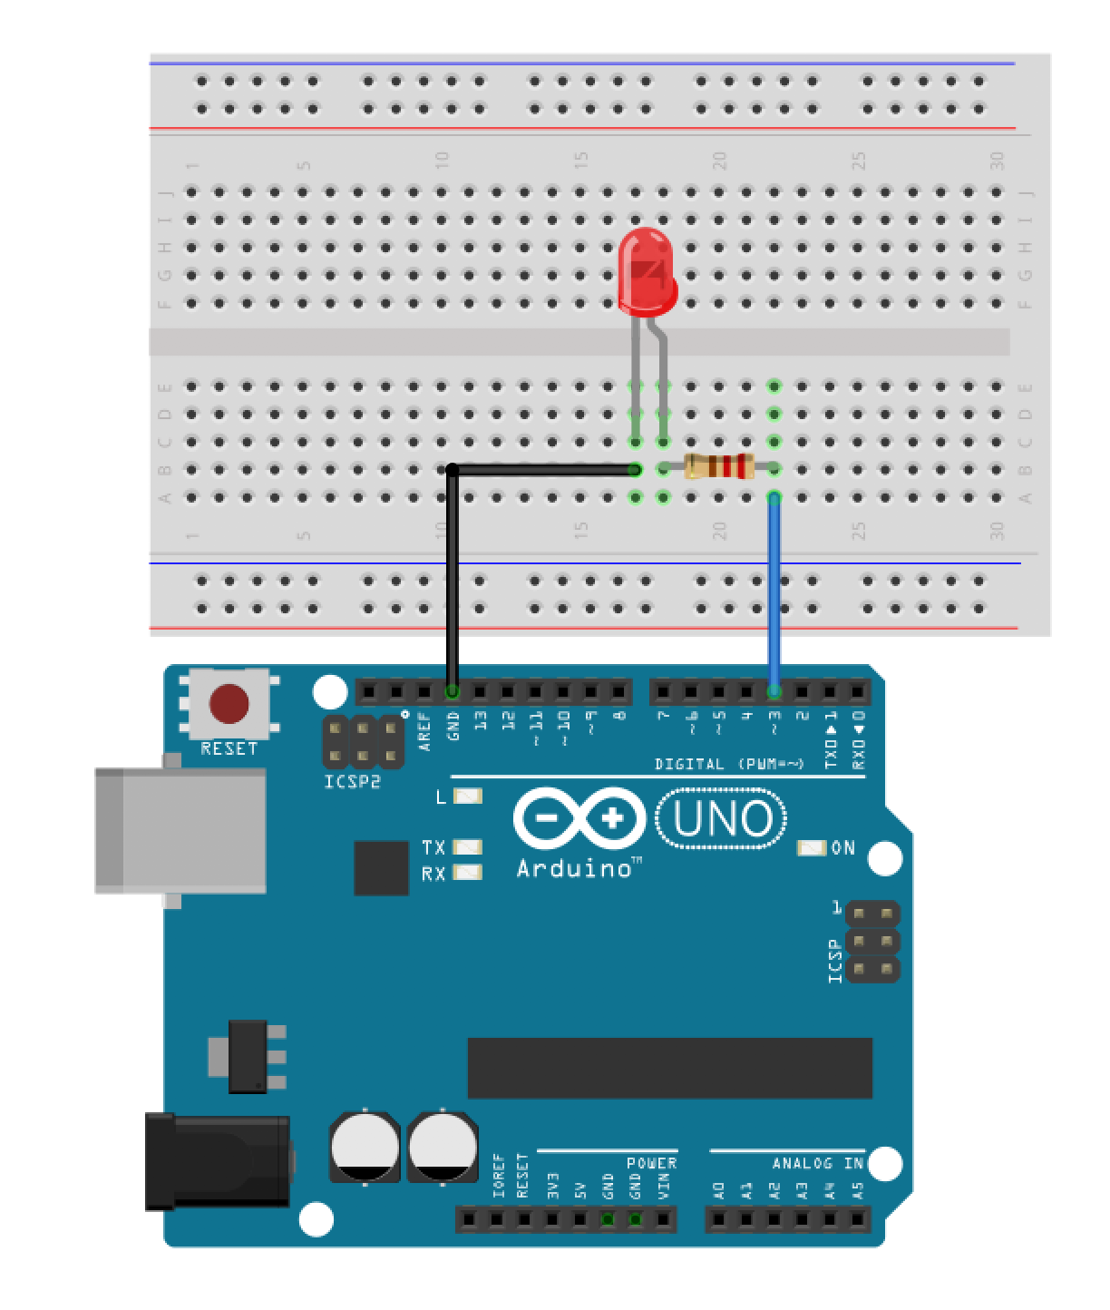
LED Anode

Slide 13
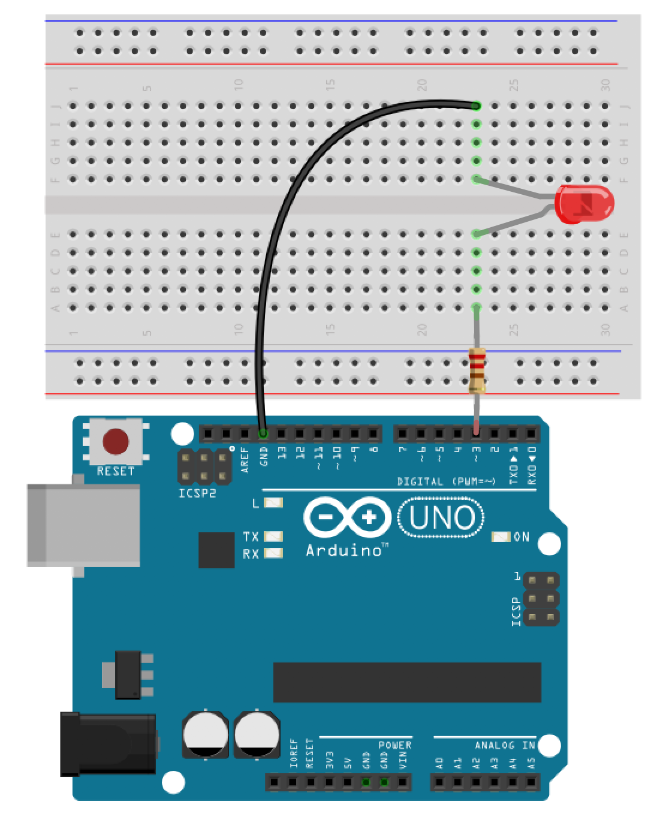
LED Anode

Slide 15
GND
5V
3.3V

Slide 16
Digital I/O Pins
At first glance, the white silkscreening “DIGITAL” seems to indicate that the Arduino Uno has 14 digital input/output (I/O) pins; however,
Six Analog Input Pins
The Arduino Uno has 6 analog input pins, which can read a voltage signal between 0-5V using the analogRead command

Slide 17
Digital I/O Pins
The Arduino Uno has 14 digital input/output (I/O) pins, which can be used to read or write digital information via the digitalRead and digitalWrite commands, respectively.

Slide 18
20 Total Digital I/O Pins
14 Digital I/O Pins
On one side of the board, the Arduino Uno has 14 digital input/output (I/O) pins, which can be used to read or write digital information via the digitalRead and digitalWrite commands, respectively.
Analog Input Pins as Digital I/O Pins
The Arduino Uno’s six analog input pins can also be used as digital I/O pins (thereby getting us to 20 total)

Slide 19
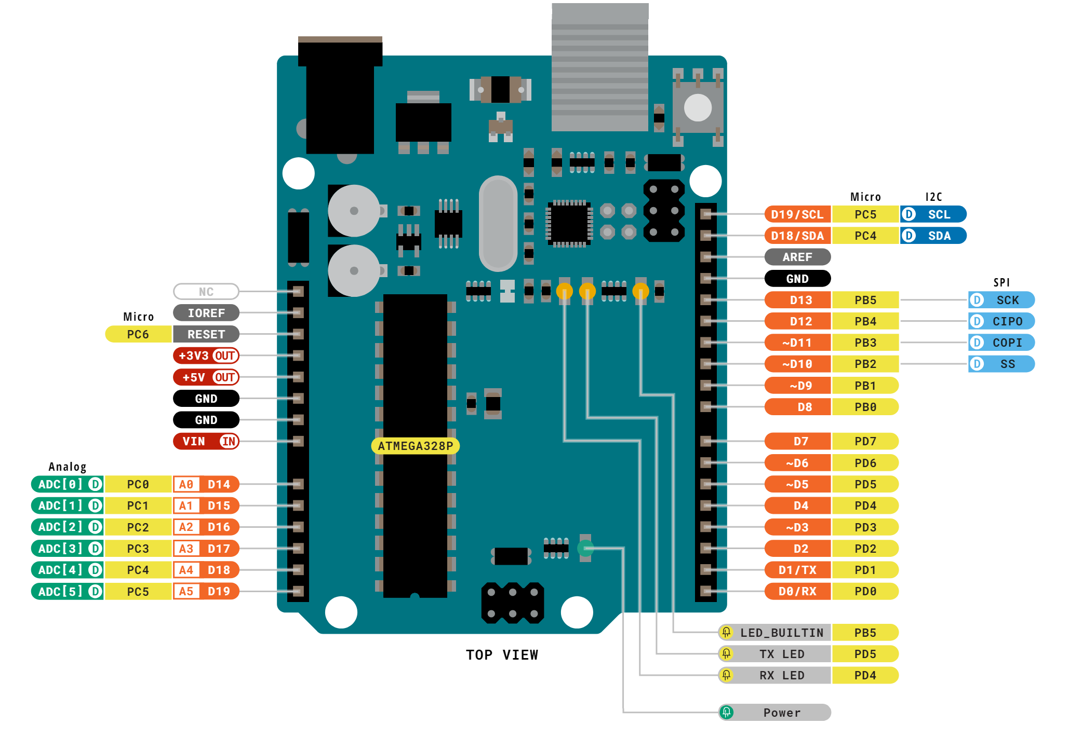
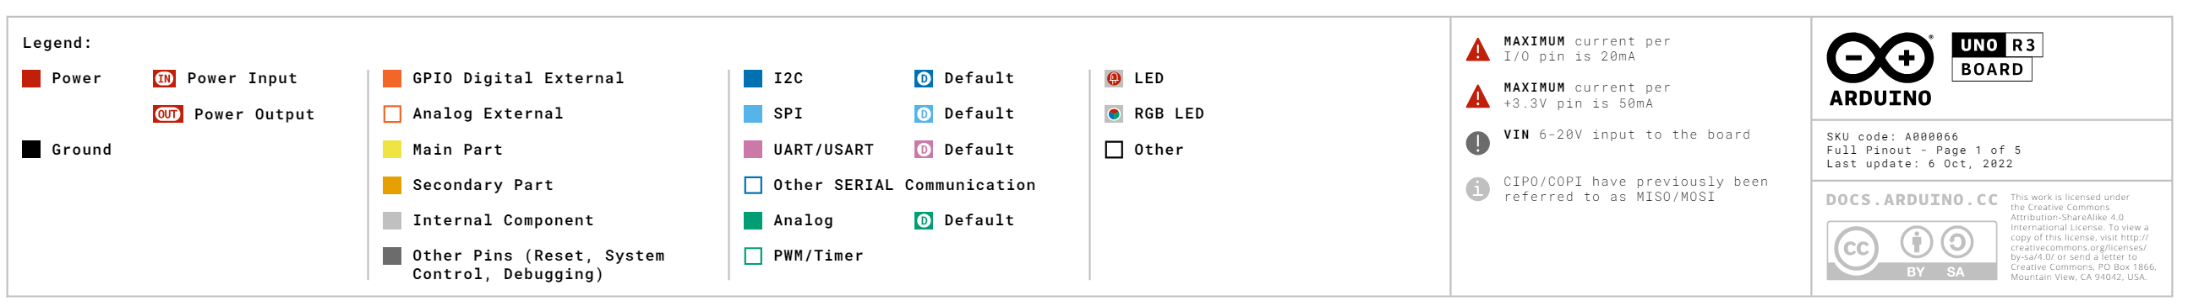
Notes:
https://docs.arduino.cc/resources/pinouts/A000066-full-pinout.pdf

Slide 20
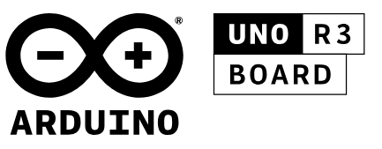
Notes:
https://docs.arduino.cc/resources/pinouts/A000066-full-pinout.pdf

Slide 21
Notes:
https://docs.arduino.cc/resources/pinouts/A000066-full-pinout.pdf

Slide 22
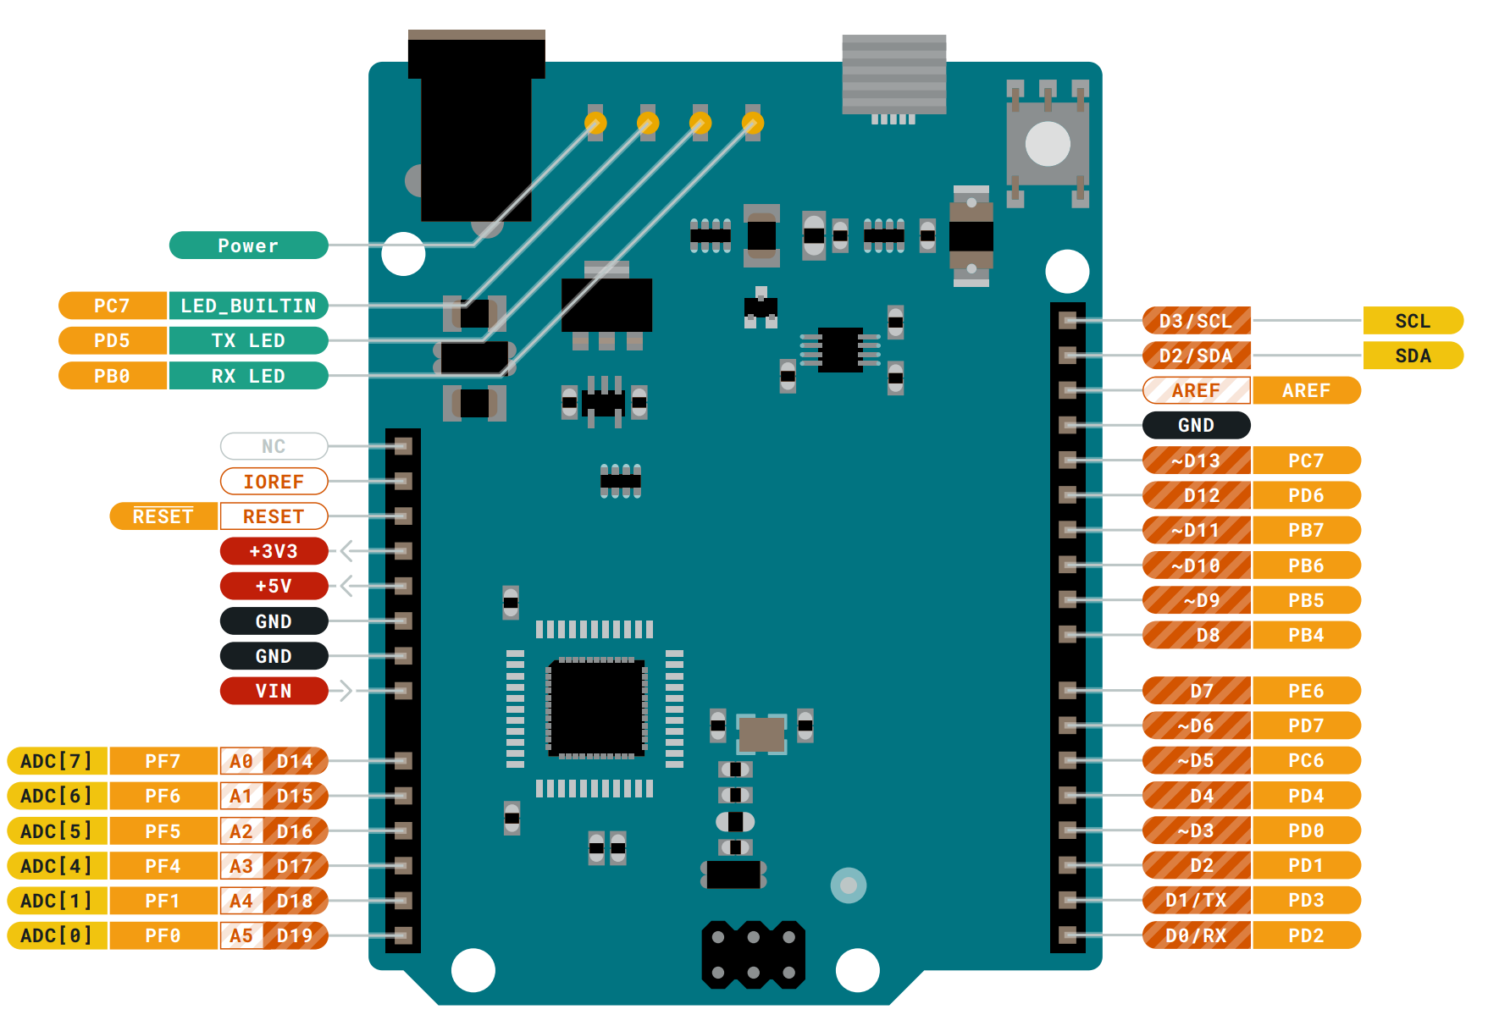
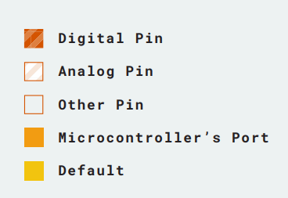
Arduino Leonardo
Notes:
Here’s the official one from Arduino
https://content.arduino.cc/assets/Pinout-Leonardo_latest.pdf

Slide 23
Analog Output Pins
The Arduino Uno has 6 analog output pins indicated by the tilde ~, which can output a voltage signal between 0 and 5V using PWM via the analogWrite command

Slide 24
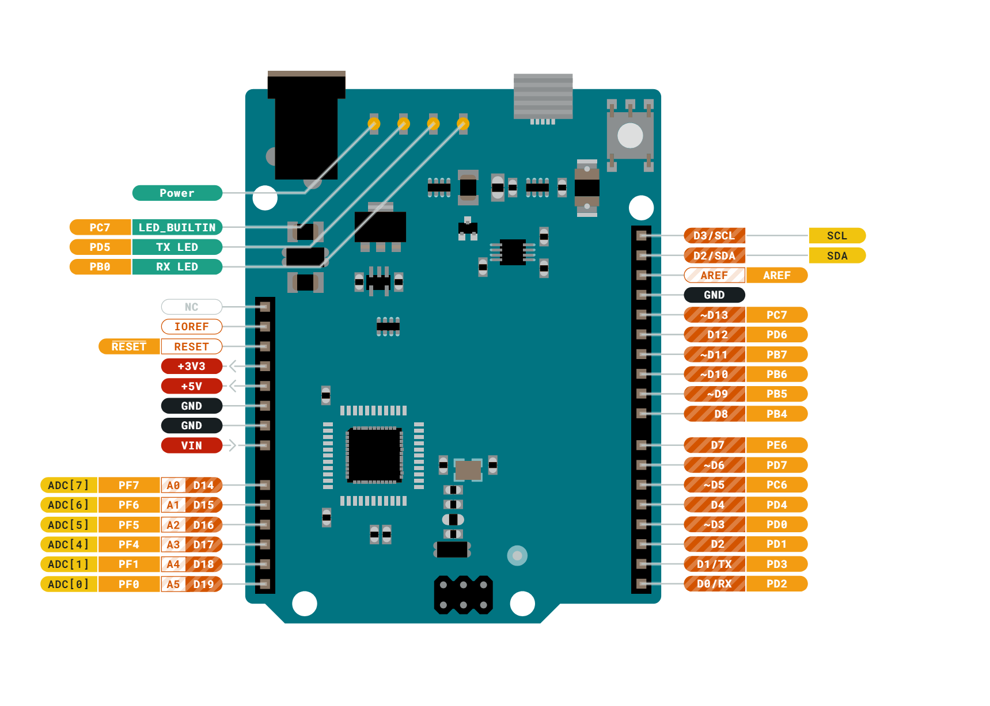
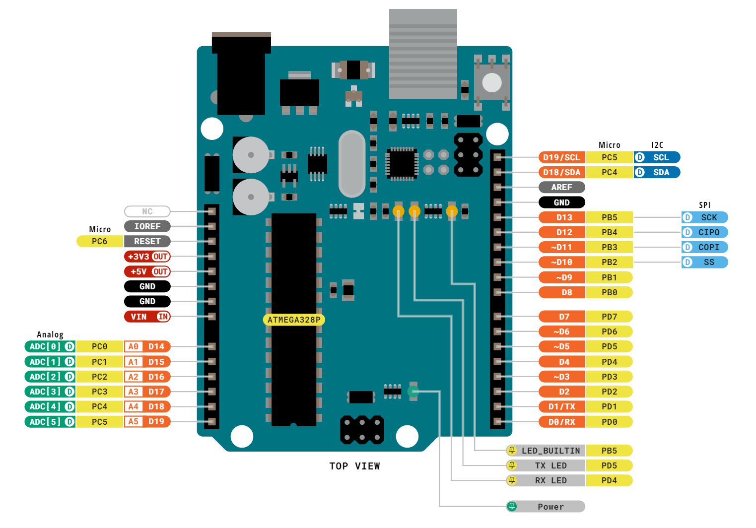
Arduino Uno
Arduino Leonardo
Notes:
Uno: https://content.arduino.cc/assets/A000066-full-pinout.pdf
Leonardo: https://content.arduino.cc/assets/Pinout-Leonardo_latest.pdf

Slide 25
Arduino Uno
Arduino Leonardo
6 PWM pins
7 PWM pins
Notes:
Uno: https://content.arduino.cc/assets/A000066-full-pinout.pdf
Leonardo: https://content.arduino.cc/assets/Pinout-Leonardo_latest.pdf

Slide 26
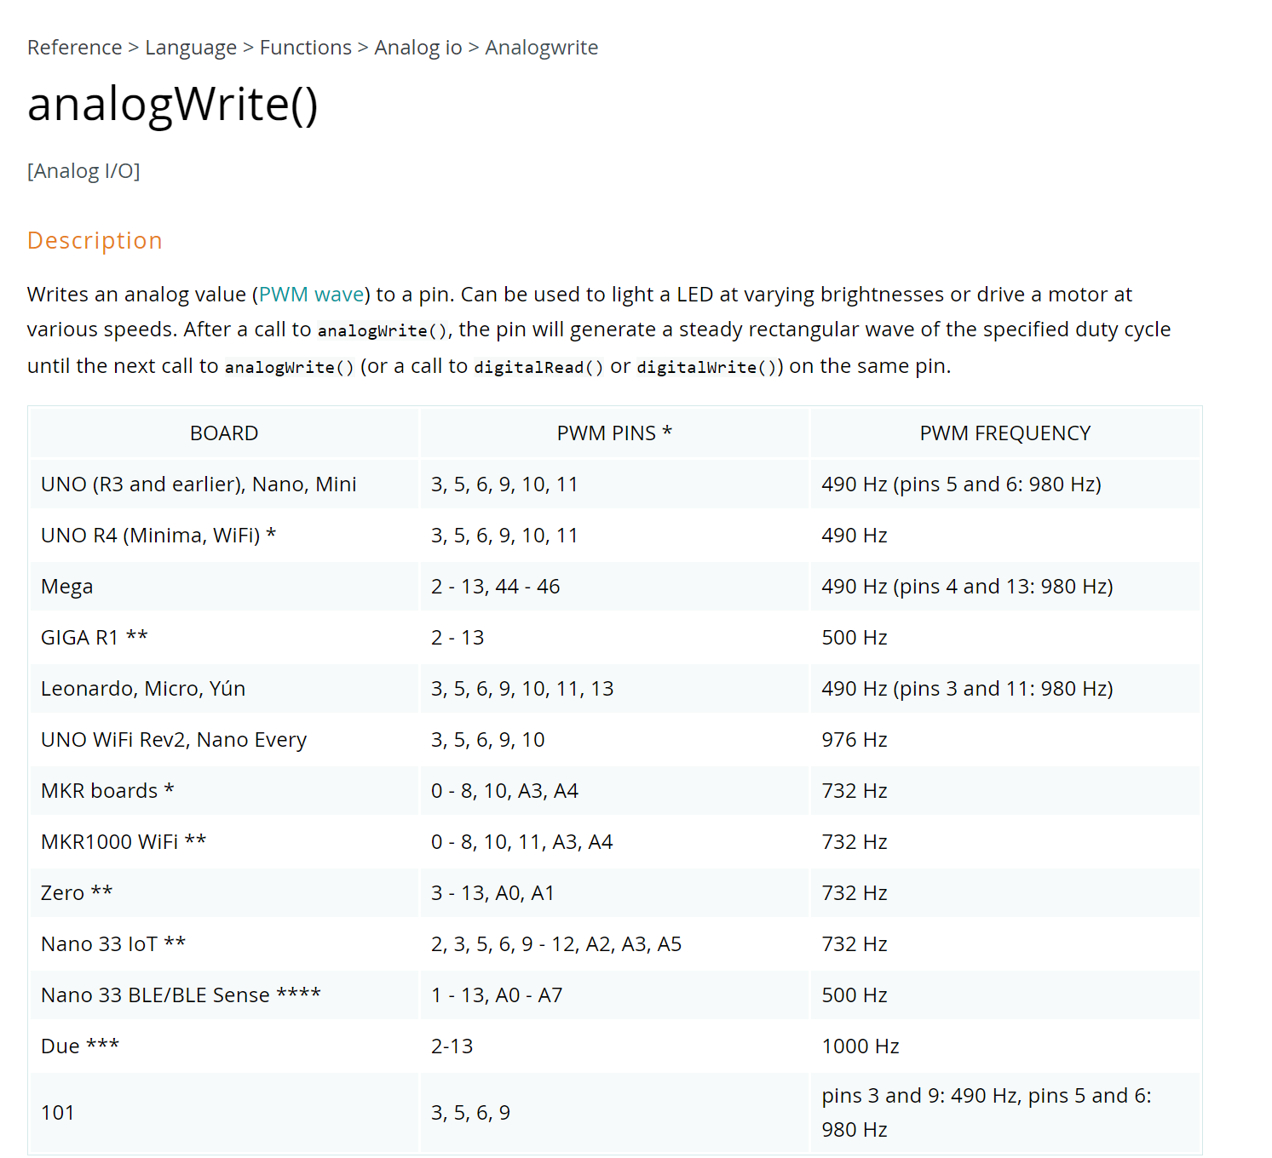
Arduino Uno
Arduino Leonardo
6 PWM pins
7 PWM pins
PWM Freq
490Hz
PWM Freq
980Hz
490Hz
490Hz
980Hz
490Hz
490Hz
980Hz
Notes:
https://www.arduino.cc/reference/en/language/functions/analog-io/analogwrite/
Uno: https://content.arduino.cc/assets/A000066-full-pinout.pdf
Leonardo: https://content.arduino.cc/assets/Pinout-Leonardo_latest.pdf

Slide 27
Controllable Built-In LED
Many Arduinos have a built-in LED (specified by the LED_BUILTIN constant) that’s controllable like any other LED with digitalWrite and digitalWrite calls. On the Arduno Uno and Leonardo, the built-in LED is here.

Slide 28
Six Analog Output Pins
The Arduino Uno has 6 analog output pins indicated by the tilde ~, which can output a voltage signal between 0 and 5V using PWM via the analogWrite command
Six Analog Input Pins
The Arduino Uno has 6 analog input pins, which can read a voltage signal between 0-5V using the analogRead command

Slide 29

Six Analog Output Pins
The Arduino Uno has 6 analog output pins indicated by the tilde ~, which can output a voltage signal between 0 and 5V using PWM via the analogWrite command
Beginners often confuse the analog output pins with the analog input pins. They’re different!
Six Analog Input Pins
The Arduino Uno has 6 analog input pins, which can read a voltage signal between 0-5V using the analogRead command

Slide 30
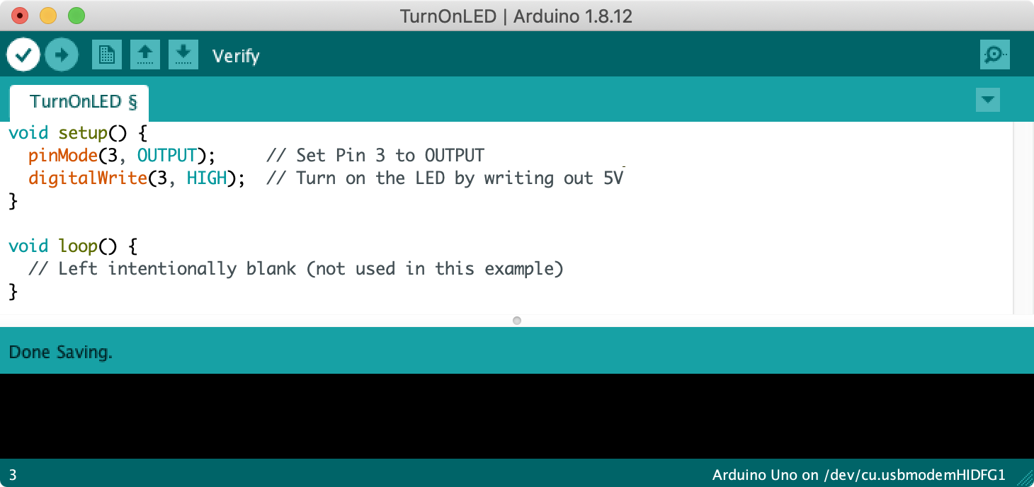
Digital I/O Pins
The Arduino Uno has 14 digital input/output (I/O) pins, which can be used to read or write digital information via the digitalRead and digitalWrite commands, respectively.

Slide 31
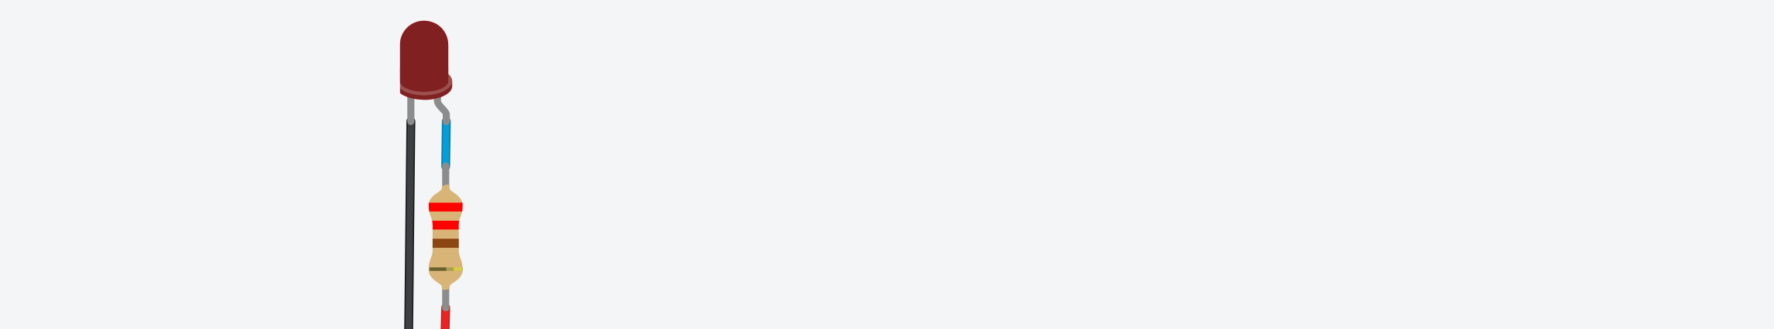

Slide 32
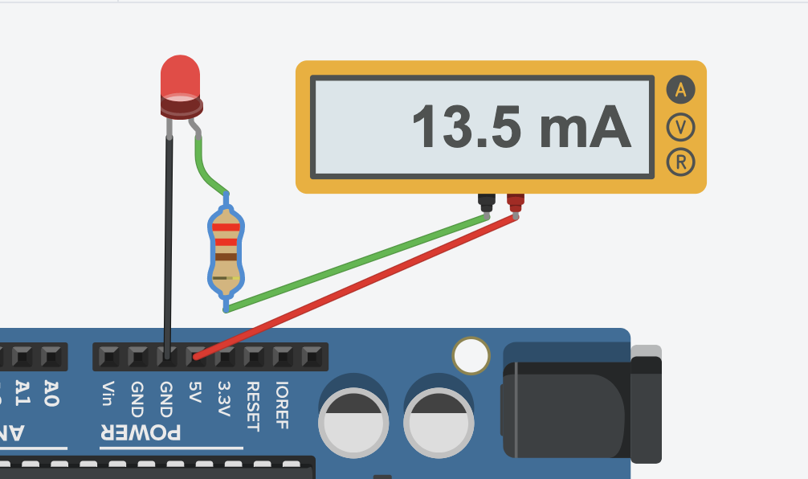

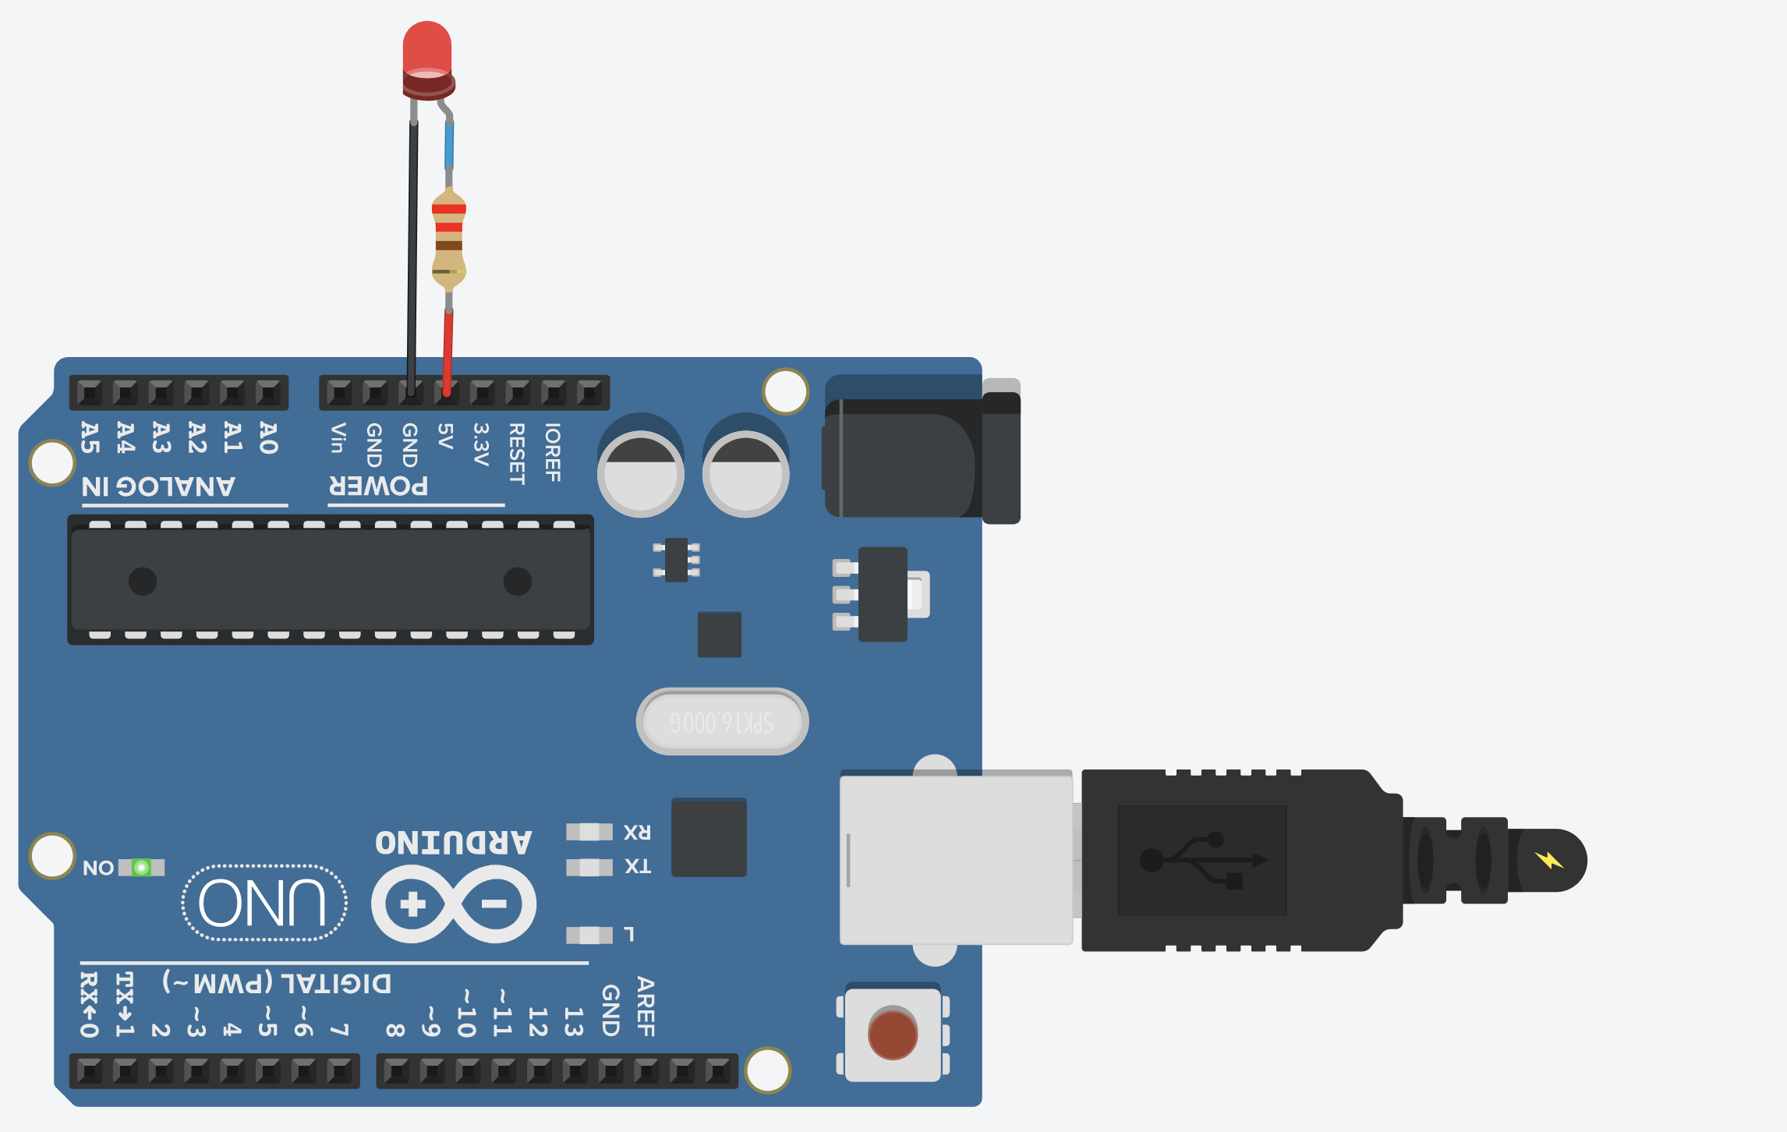

Slide 33
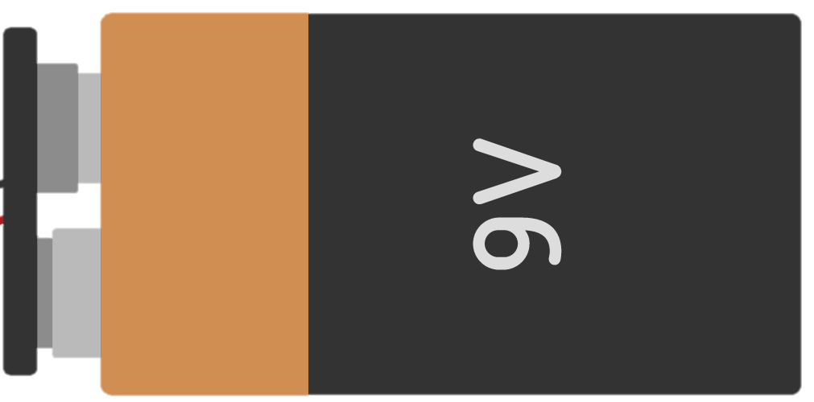
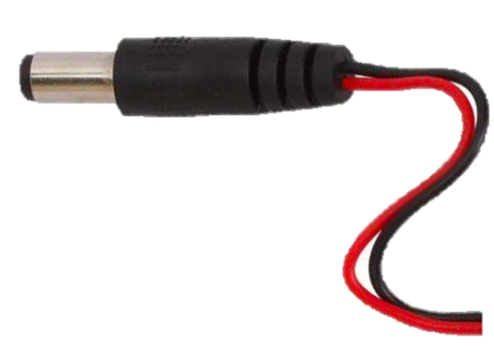

Slide 34
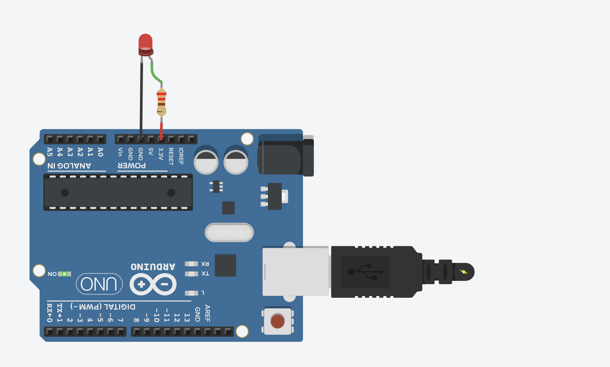
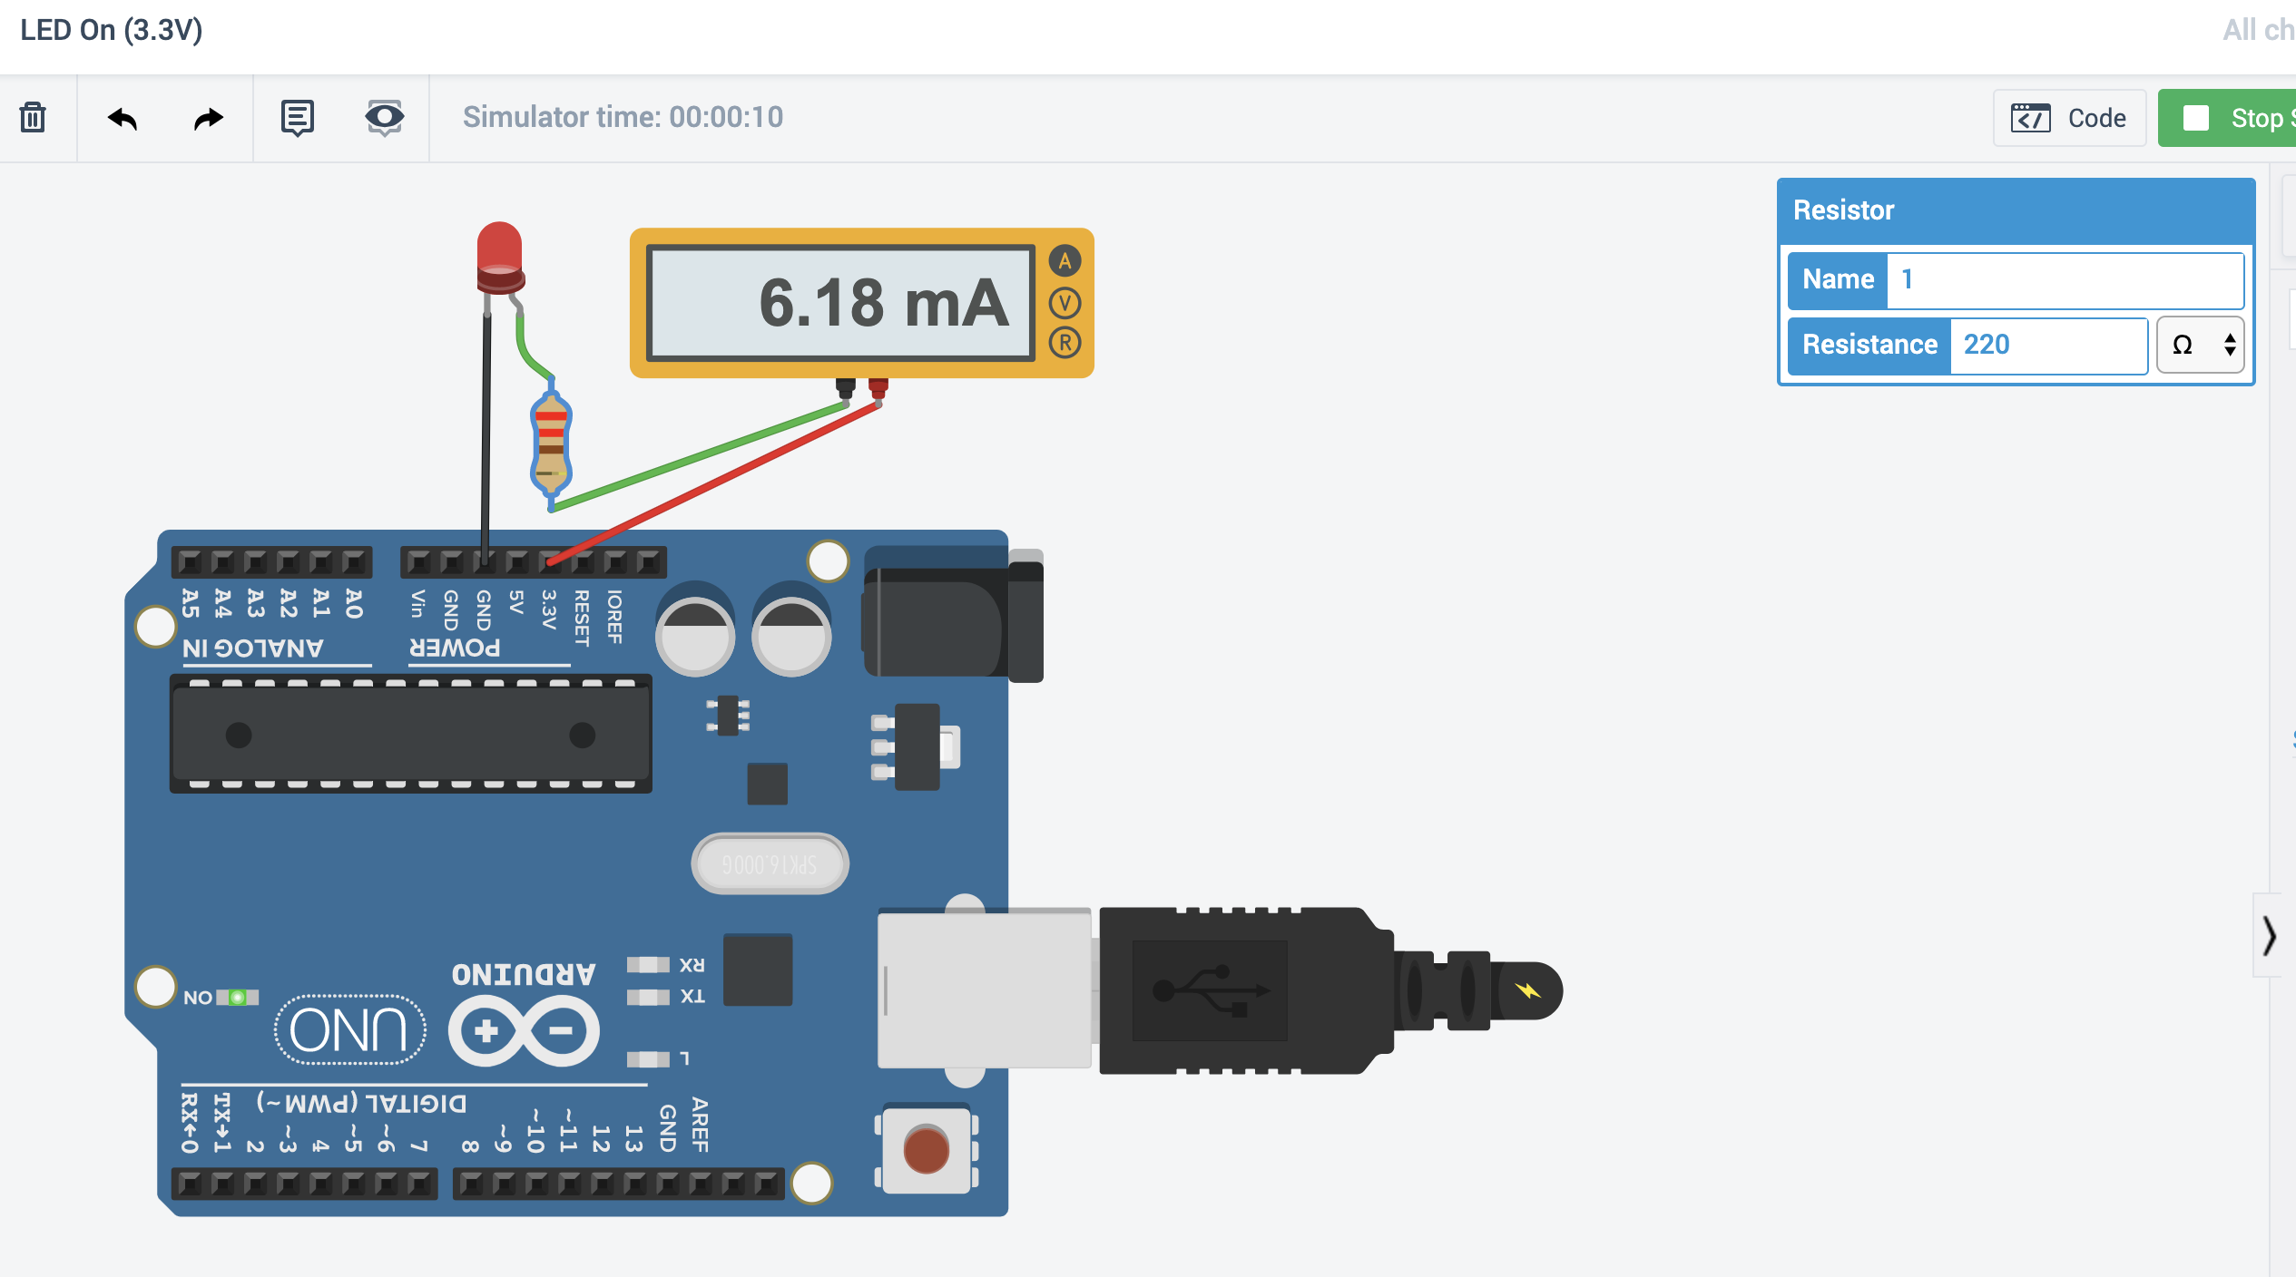
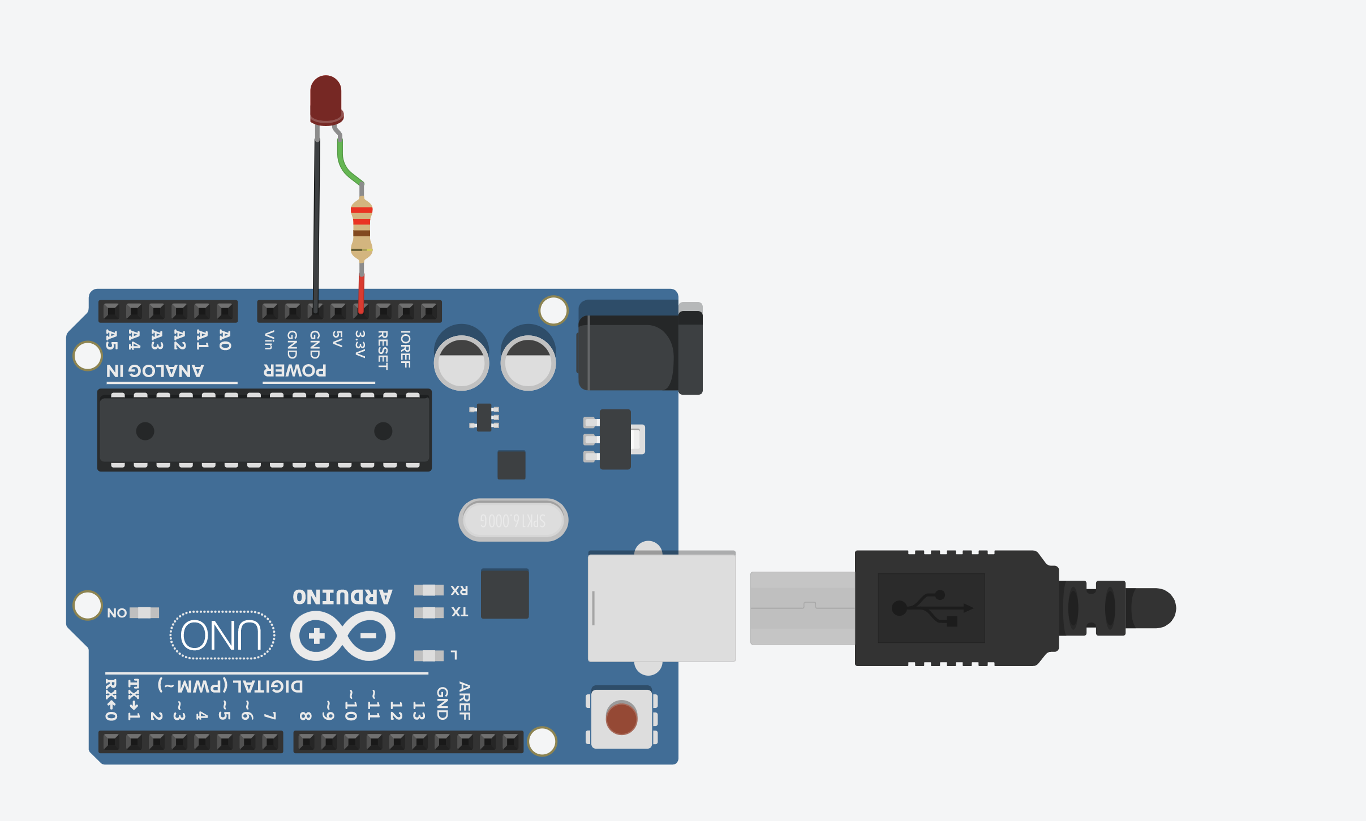
220Ω

Slide 36
LED On
Show LED built-in example?
Show breadboard variant?

Slide 37
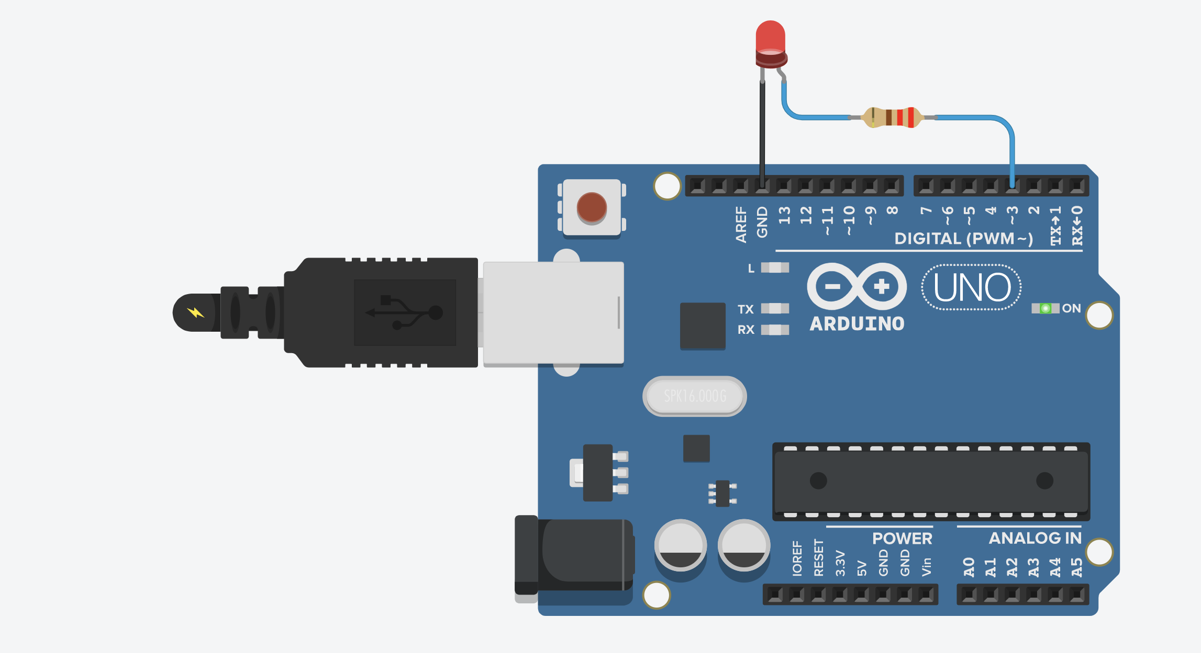
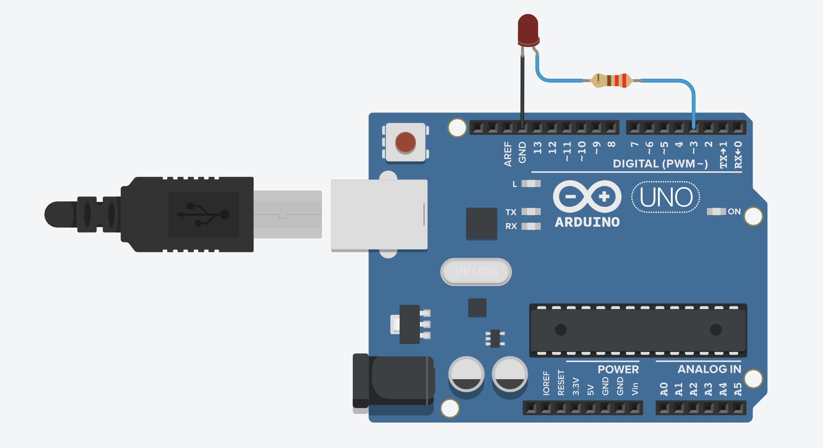
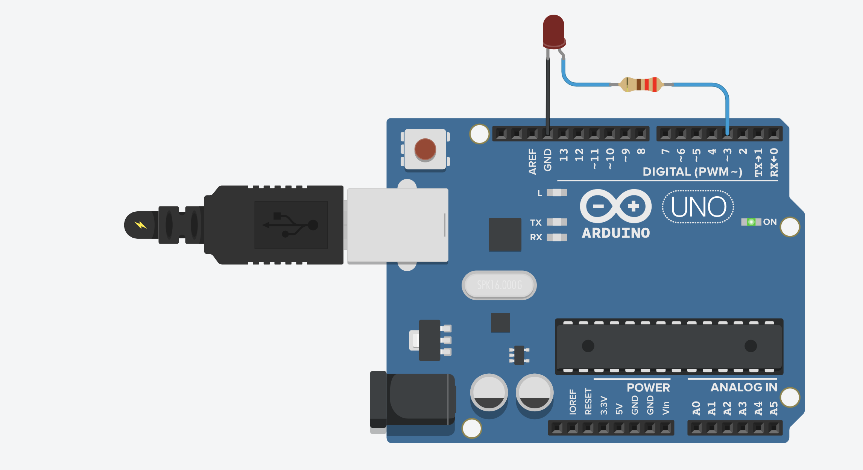

Slide 38
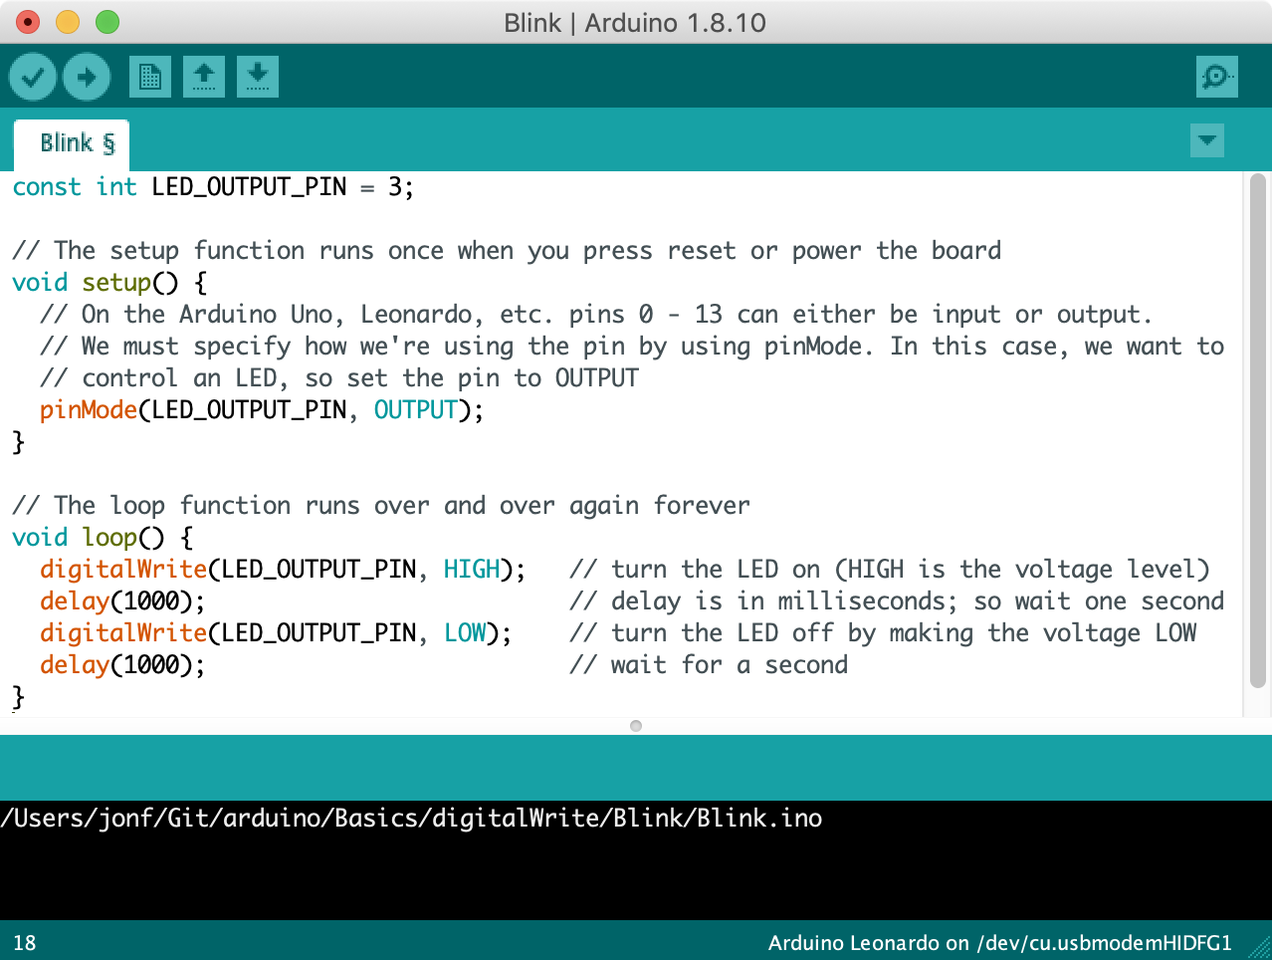
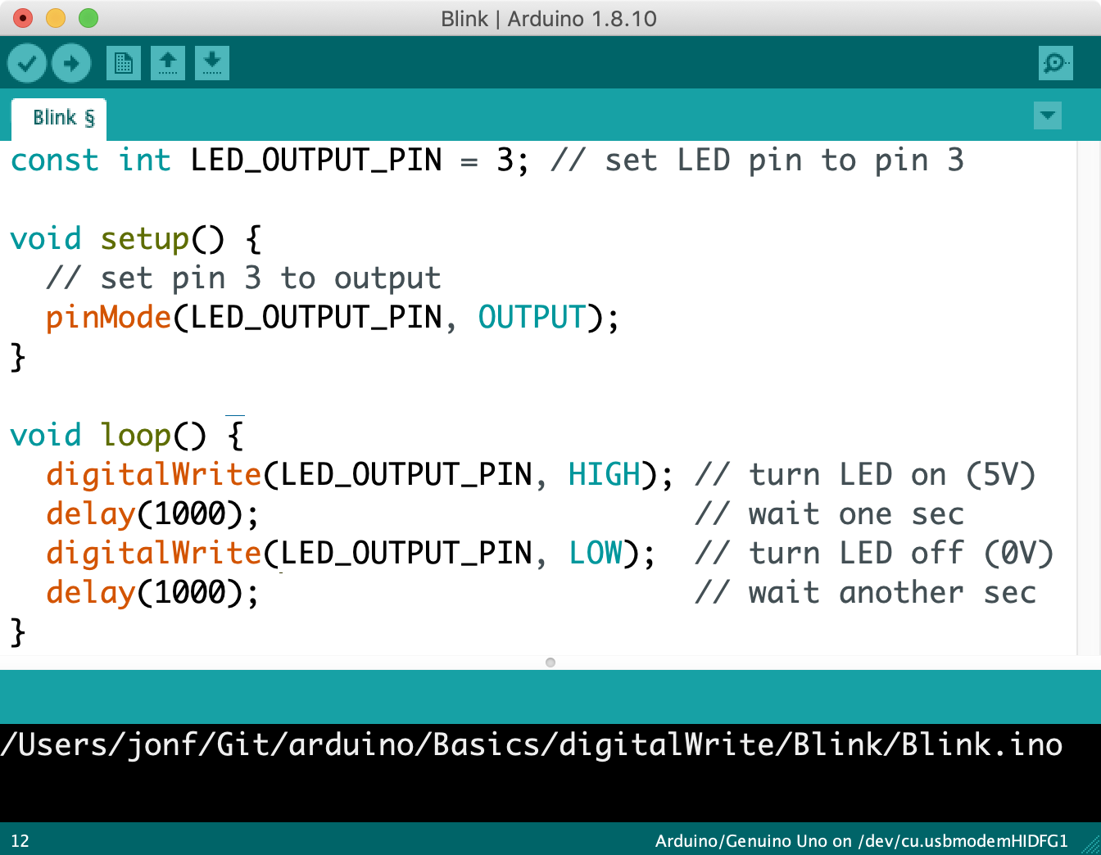

Slide 39
Arduino powered on
setup() is called immediately once and only once. Put your initialization code here.
Run initial setup() code
Pins 0 – 13 can be either input or output. Set Pin 3 to output to control the connected LED.
After setup(), loop() is called
After setup() completes, loop() is called automatically. When loop() ends, it is run again and again (until the Arduino is shut off or reprogrammed)
digitalWrite(3, HIGH)
Output a HIGH signal (5V) on Pin 3 and then wait for one second
digitalWrite(3, LOW)
Output a LOW signal (0V) on Pin 3 and then wait for one second
End of loop(), call loop() again
When loop() ends, it is called again automatically. This loop continues forever.
Notes:
The program running on the Arduino, which continuously alternates between outputting 5V on Pin 3 for one second and outputting 0V.

Slide 40
Arduino powered on
setup() is called immediately once and only once. Put your initialization code here.
Run initial setup() code
Pins 0 – 13 can be either input or output. Set Pin 3 to output to control the connected LED.
After setup(), loop() is called
After setup() completes, loop() is called automatically. When loop() ends, it is run again and again (until the Arduino is shut off or reprogrammed)
digitalWrite(3, HIGH)
Output a HIGH signal (5V) on Pin 3 and then wait for one second
digitalWrite(3, LOW)
Output a LOW signal (0V) on Pin 3 and then wait for one second
End of loop(), call loop() again
When loop() ends, it is called again automatically. This loop continues forever.
Notes:
The program running on the Arduino, which continuously alternates between outputting 5V on Pin 3 for one second and outputting 0V.

Slide 41
Arduino powered on
setup() is called immediately once and only once. Put your initialization code here.
Run initial setup() code
Pins 0 – 13 can be either input or output. Set Pin 3 to output to control the connected LED.
After setup(), loop() is called
After setup() completes, loop() is called automatically. When loop() ends, it is run again and again (until the Arduino is shut off or reprogrammed)
digitalWrite(3, HIGH)
Output a HIGH signal (5V) on Pin 3 and then wait for one second
digitalWrite(3, LOW)
Output a LOW signal (0V) on Pin 3 and then wait for one second
End of loop(), call loop() again
When loop() ends, it is called again automatically. This loop continues forever.
Notes:
The program running on the Arduino, which continuously alternates between outputting 5V on Pin 3 for one second and outputting 0V.

Slide 43
LED On
Show LED built-in example?
Show breadboard variant?

Slide 44
Screenshot tips on mac
Hit Cmd-Shift-5
When screenshooting full window, hold option when over a window to disable the dropshadow

Slide 45
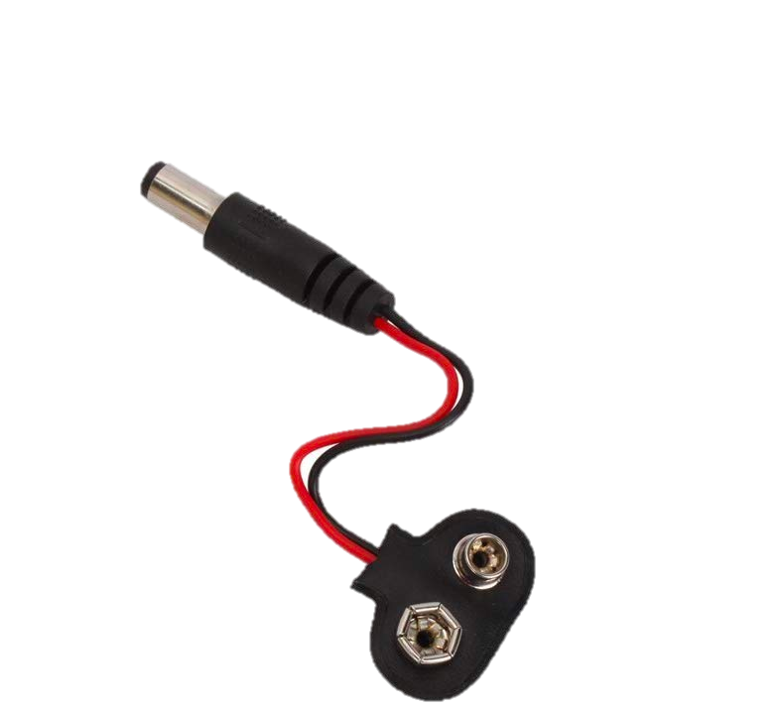

Slide 46
Notes:
https://support.office.com/en-us/article/make-an-animated-gif-from-a-slide-show-a598753e-92de-4f1b-8393-714db4d334b4

